Slide 1
Yvonne Li

Slide 2
2025 EOY Bonus

Slide 3
Bonus
Bonus Depends on company results & your results
2025 sales were down vs. 2024 and vs. our target.
However, we did a better job of managing our costs and improved our profitability.
Flyers can receive up to 100% of their bonus.
Your 2025 Bonus Potential
RMB 1,091 2 Months
Your 2025 Actual Bonus
RMB 2,077 6 Months 3% of Potential

Slide 4
2026

Slide 5
2026 Salary
Current Salary
RMB 3,076 Per month
2026 Salary
RMB 4,013 Per month
Merit Increase %
9 %
2026 Bonus Potential
RMB 5,064 1 Months

Slide 6
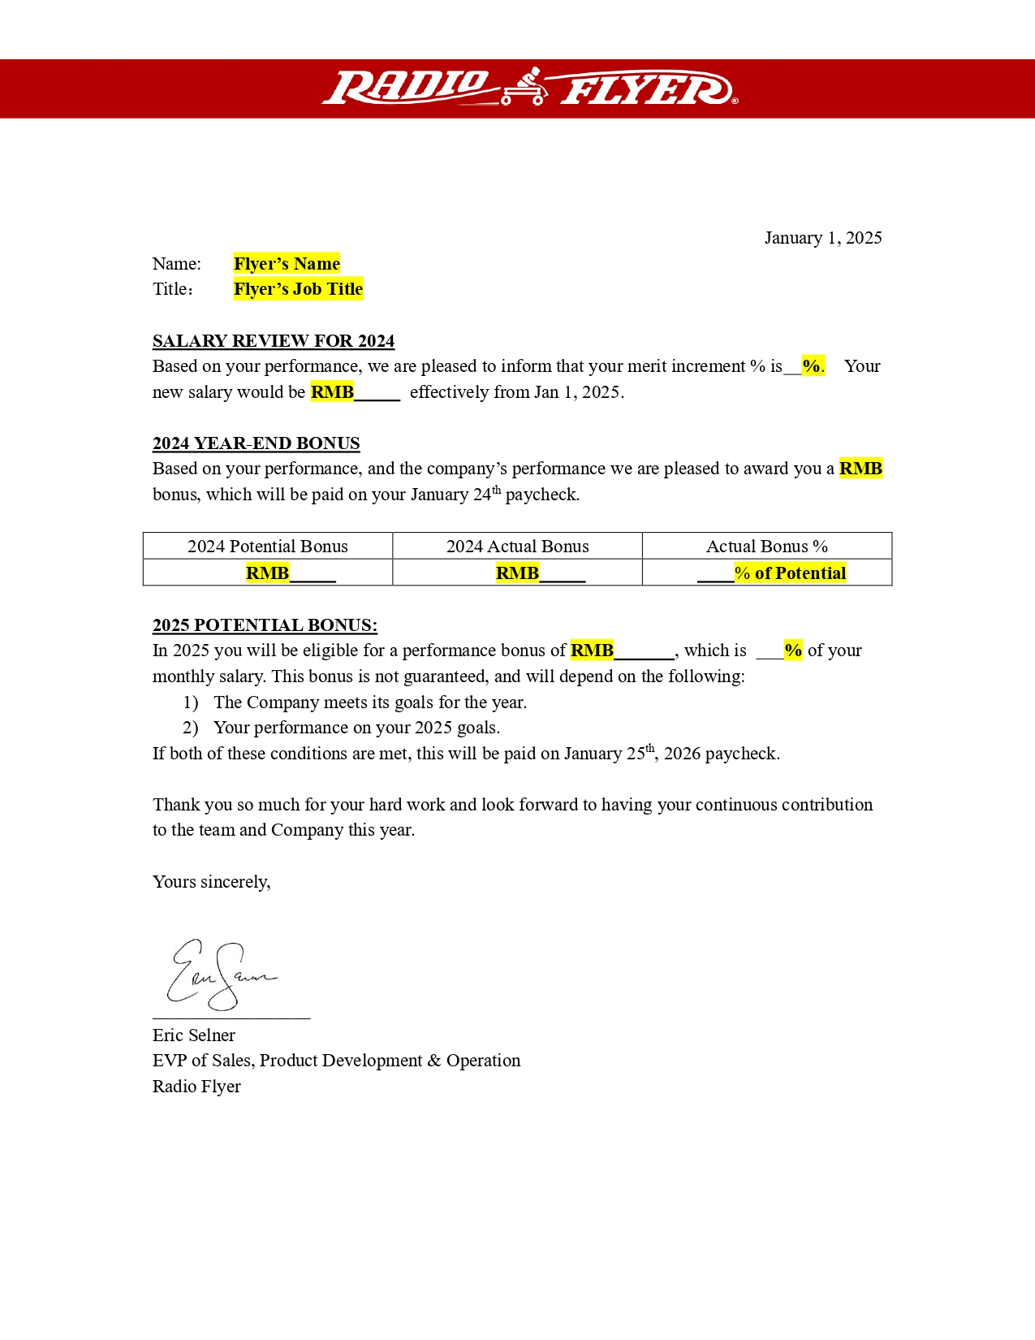
Image: Flyer’s salary letter

Slide 8
Donna Yang

Slide 9
2025 EOY Bonus

Slide 10
Bonus
Bonus Depends on company results & your results
2025 sales were down vs. 2024 and vs. our target.
However, we did a better job of managing our costs and improved our profitability.
Flyers can receive up to 100% of their bonus.
Your 2025 Bonus Potential
RMB 1,076 4 Months
Your 2025 Actual Bonus
RMB 2,019 6 Months 8% of Potential

Slide 11
2026

Slide 12
2026 Salary
Current Salary
RMB 3,005 Per month
2026 Salary
RMB 4,086 Per month
Merit Increase %
8 %
2026 Bonus Potential
RMB 5,062 8 Months

Slide 13
Image: Flyer’s salary letter

Slide 15
Lucia Zhao

Slide 16
2025 EOY Bonus

Slide 17
Bonus
Bonus Depends on company results & your results
2025 sales were down vs. 2024 and vs. our target.
However, we did a better job of managing our costs and improved our profitability.
Flyers can receive up to 100% of their bonus.
Your 2025 Bonus Potential
RMB 1,065 0 Months
Your 2025 Actual Bonus
RMB 2,080 6 Months 5% of Potential

Slide 18
2026

Slide 19
2026 Salary
Current Salary
RMB 3,070 Per month
2026 Salary
RMB 4,092 Per month
Merit Increase %
8 %
2026 Bonus Potential
RMB 5,068 0 Months

Slide 20
Image: Flyer’s salary letter

Slide 22
Selina Lian

Slide 23
2025 EOY Bonus

Slide 24
Bonus
Bonus Depends on company results & your results
2025 sales were down vs. 2024 and vs. our target.
However, we did a better job of managing our costs and improved our profitability.
Flyers can receive up to 100% of their bonus.
Your 2025 Bonus Potential
RMB 1,046 2 Months
Your 2025 Actual Bonus
RMB 2,062 2 Months 7% of Potential

Slide 25
2026

Slide 26
2026 Salary
Current Salary
RMB 3,097 Per month
2026 Salary
RMB 4,089 Per month
Merit Increase %
8 %
2026 Bonus Potential
RMB 5,091 8 Months

Slide 27
Image: Flyer’s salary letter

Slide 29
April Jing

Slide 30
2025 EOY Bonus

Slide 31
Bonus
Bonus Depends on company results & your results
2025 sales were down vs. 2024 and vs. our target.
However, we did a better job of managing our costs and improved our profitability.
Flyers can receive up to 100% of their bonus.
Your 2025 Bonus Potential
RMB 1,019 3 Months
Your 2025 Actual Bonus
RMB 2,039 8 Months 7% of Potential

Slide 32
2026

Slide 33
2026 Salary
Current Salary
RMB 3,080 Per month
2026 Salary
RMB 4,060 Per month
Merit Increase %
2 %
2026 Bonus Potential
RMB 5,047 8 Months

Slide 34
Image: Flyer’s salary letter

